Slide 1

STOCK MARKET BIG DATA ANALYTICS
Name: Sanchayan V
Student ID: U2380760
Module: CMS3504

Slide 2

INTRODUCTION
Understanding the stock market and predicting stock prices is a challenging task due to its complexity. Using PySpark for effective data management, we tackled this difficulty in the Big Data Analysis (BDA) assignment by analysing the 'AMEX, NYSE, NASDAQ stock histories' dataset.
We specifically looked into the stock market trends of the top 5 car companies: Ford, General Motors, Honda, Tesla, and Toyota, through Exploratory Data Analysis (EDA).
Eventually, we decided to use Recurrent Neural Networks (RNN) and the Long-Short Term Memory (LSTM) model to generate a predictive model for the Ford stock market dataset.
To assess our predictions, we used metrics like Root Mean Squared Error (RMSE), Mean Absolute Percentage Error (MAPE), and R-squared (R2). To boost the model's performance, we tweaked hyperparameters and conducted a detailed comparative analysis to find the most effective model.

Slide 3
Feature Description
Date: Represents the temporal aspect, indicating specific points in time.
Volume: Reflects the trading activity, representing the total number of shares traded during a specific period.
Open: Indicates the opening value of a stock, i.e., the initial price when trading begins.
High: Represents the highest value of a stock during a given trading day.
Low: Represents the lowest value of a stock during a given trading day.
Close: Reflects the closing value of a stock, i.e., the price at the end of the trading day.
Adjclose: Likely represents an adjusted closing value, accounting for corporate actions like dividends and stock splits.
Symbol: Identifies the stock associated with the financial data.
Feature Categorization
Temporal Features: Date
Quantitative Features:
Continuous: Volume, Open, High, Low, Close, Adjclose
Qualitative Features: Symbol

Slide 4
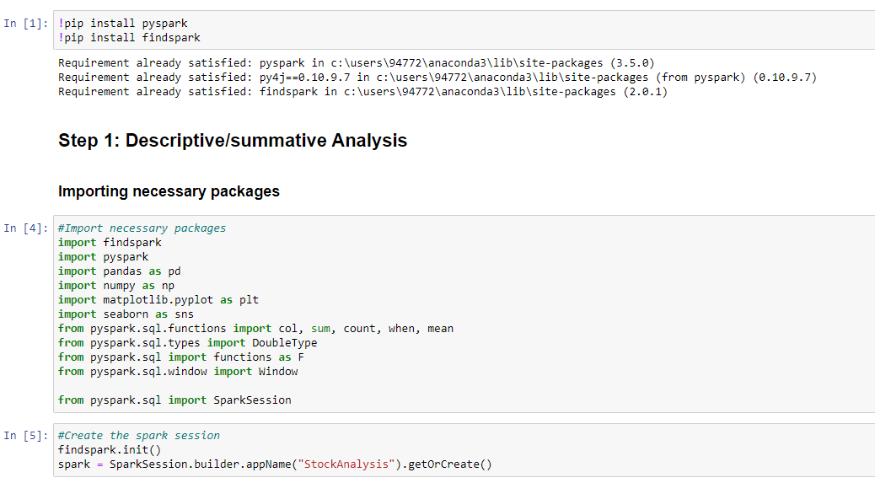
Initiating PySpark Session

Slide 5
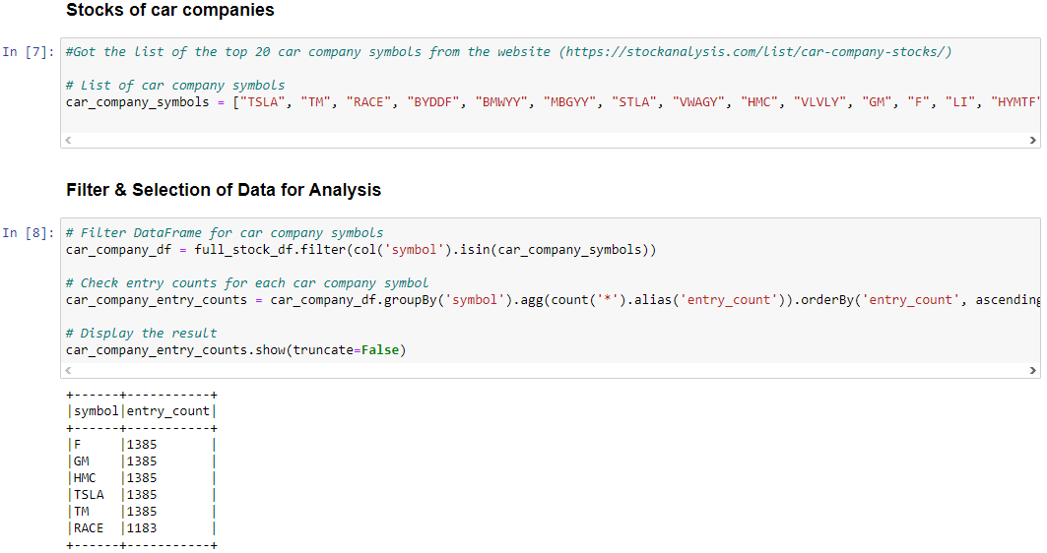
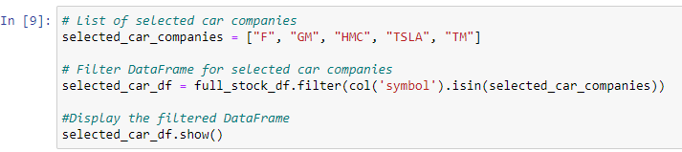
Filtering & Preprocessing
Criteria and Selection:
Chose top 20 car company stocks from (https://stockanalysis.com/list/car-company-stocks/).
Verified their presence in the dataset.
Data-driven Prioritization:
Analysed entry frequency for each stock.
Focused on Ford, General Motors, Honda, Tesla, and Toyota with higher entry counts.
Quantitative Focus:
Emphasizing on stocks with more entries for in-depth analysis.
Primary Stocks:
Primary focus on Ford, General Motors, Honda, Tesla, and Toyota for detailed examination.

Slide 6
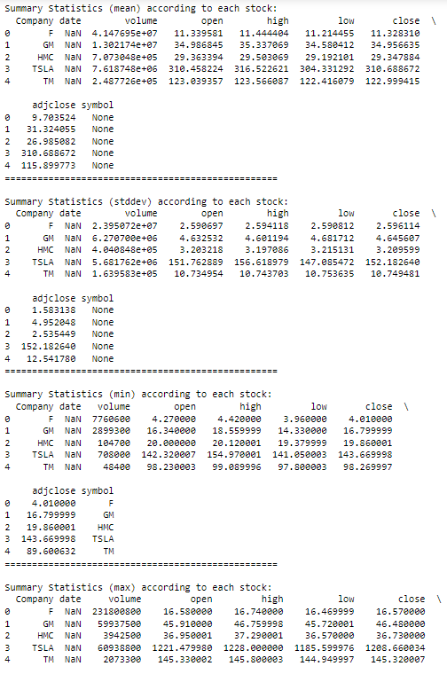
Descriptive/Summative Analysis
Closing Prices:
Tesla (TSLA) leads with the highest mean closing price at approximately 310.69, reflecting its unique standing in the market.
Honda (HMC) has a comparatively lower mean closing price of around 29.35, while General Motors (GM), Toyota (TM), and Ford (F) fall in between.
Tesla exhibits higher volatility in closing prices, evident in its larger standard deviation, while other companies display relatively lower volatility.
Trading Volumes:
Tesla also stands out with the highest mean trading volume at approximately 7.62 million, indicating robust and active market participation.
Honda, with a mean volume of around 707,305, showcases a more restrained level of market activity.
General Motors, Toyota, and Ford fall in between, with varying mean trading volumes.

Slide 7

TIME SERIES ANALYSIS

Slide 8
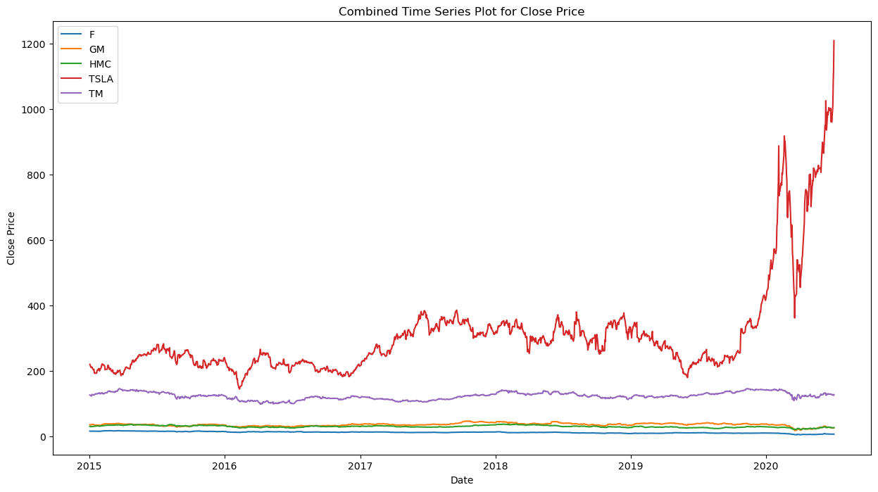
Closing Price
Tesla's Dynamics:
Notable fluctuations, surge post-2019, dip in 2020, resilient recovery.
GM and Honda Stability:
Stable patterns, less volatility compared to Tesla.
Ford's Steady Performance:
Consistently low prices, reflecting modest and steady performance.
Market Overview:
Tesla's dynamics overshadow GM and Honda’s stability.
Ford maintains a consistently modest performance.

Slide 9
MOVING AVERAGE(MA)METHOD

Slide 10
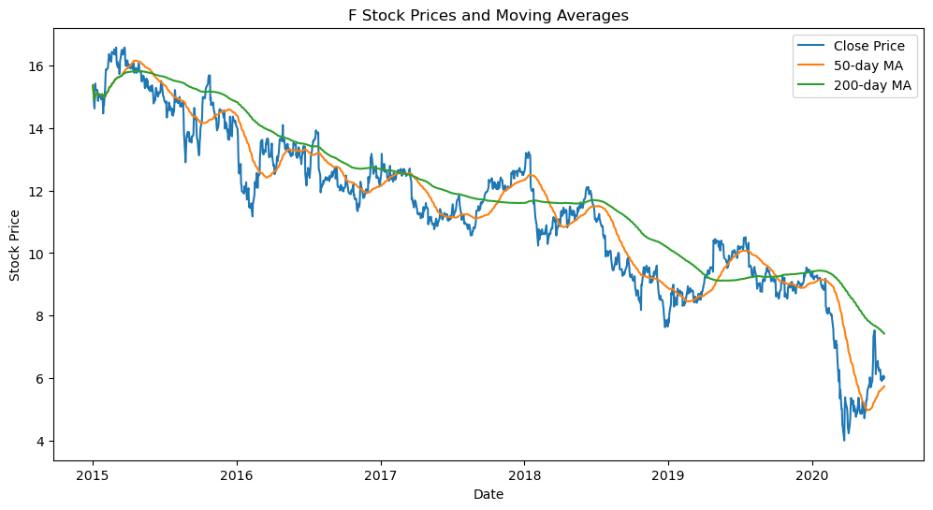
Ford Stock Prices and Moving Averages
The 200-day Moving Average (MA) for Ford (F) reveals a consistent decline in stock prices from 2015 to 2020. This indicates a gradual decrease in the value of Ford stocks over the observed period.

Slide 11
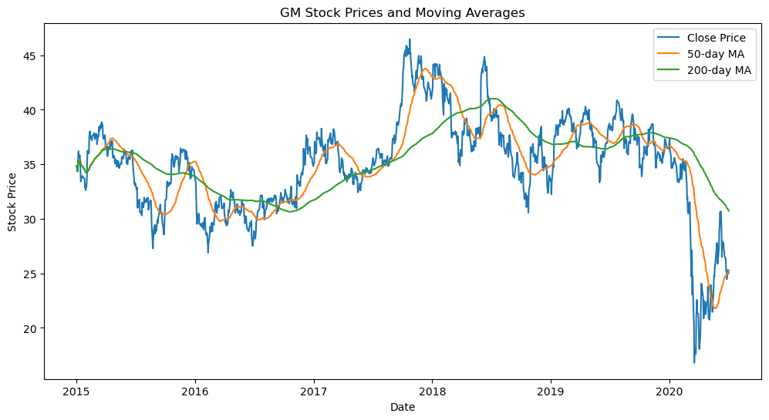
General Motors(GM) Stock Prices and Moving Averages
General Motors (GM) exhibits fluctuating stock prices, with a notable peak observed between 2017 and 2018. Despite fluctuations, the stock price did not exhibit a consistent upward or downward trend during the observed period.

Slide 12
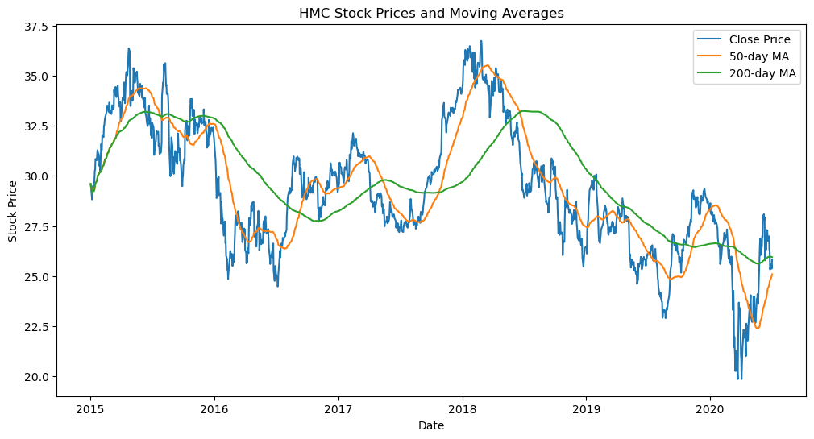
Honda(HMC) Stock Prices and Moving Averages
Honda's (HMC) stock prices demonstrate high volatility, reaching peaks in 2015-2016 and 2018-2019. Subsequently, the stock exhibits a gradual decline, indicating fluctuating market dynamics.

Slide 13
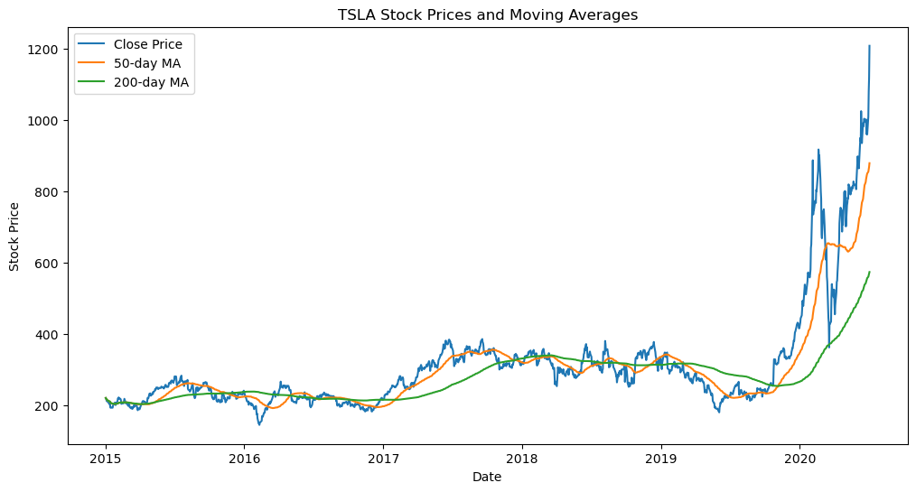
Tesla(TSLA) Stock Prices and Moving Averages
Tesla's (TSLA) stock prices remained relatively stable from 2015 to mid-2019, followed by a significant surge after 2020. This suggests a remarkable increase in investor confidence and market value during the latter period.

Slide 14
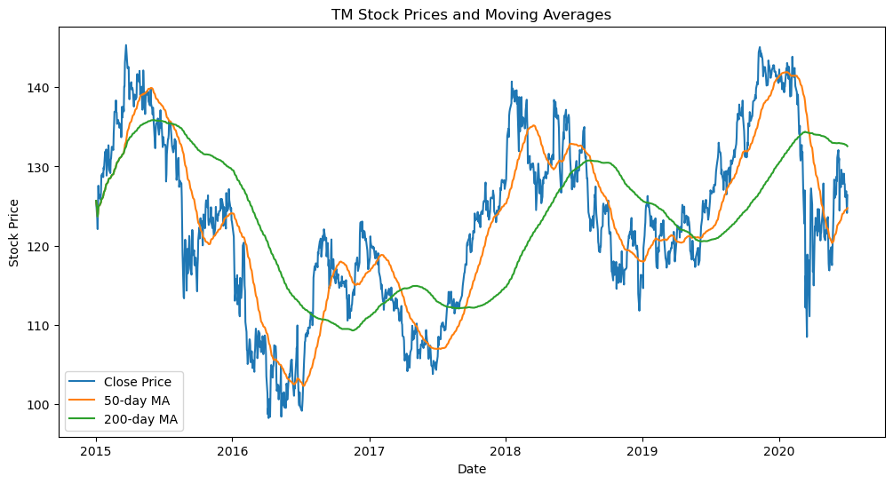
Toyota(TM) Stock Prices and Moving Averages
Toyota (TM) experiences the highest level of fluctuation among the selected car companies. The stock price underwent a substantial decline between 2016 and 2017, reflecting the challenges faced by the company during that period.

Slide 15
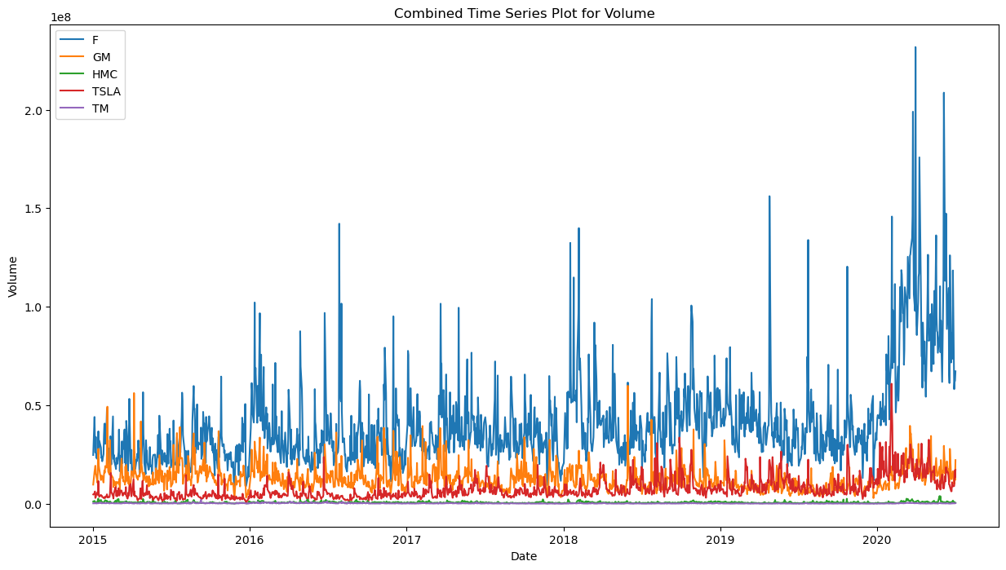
Volume
Volume Comparison:
Ford and Tesla: Higher average trading volumes, reflecting robust investor interest.
Honda and Toyota: Lower average volumes, indicating a more stable market activity compared to Ford and Tesla.
Volatility in Trading Volumes:
Tesla: Higher volatility, attributed to its innovative image, market reactions, and speculative trading.
Other Stocks (Ford, Honda, Toyota): Lower volatility, associated with established positions, attracting steadier investor interest.

Slide 16
MOVING AVERAGE(MA)METHOD

Slide 17
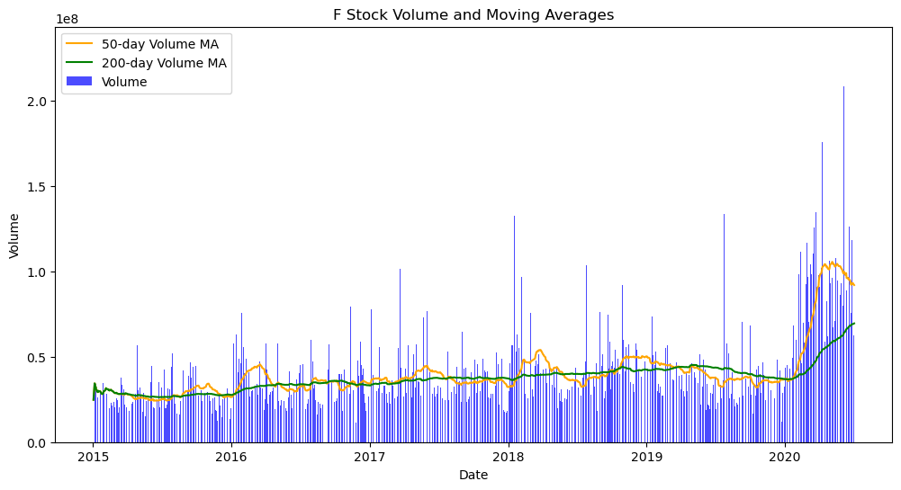
Ford Stock Volume and Moving Averages
Exhibits a generally increasing trend in stock volume over time, with a noticeable dip in 2020. The volume quickly recovered and experienced a significant surge.

Slide 18
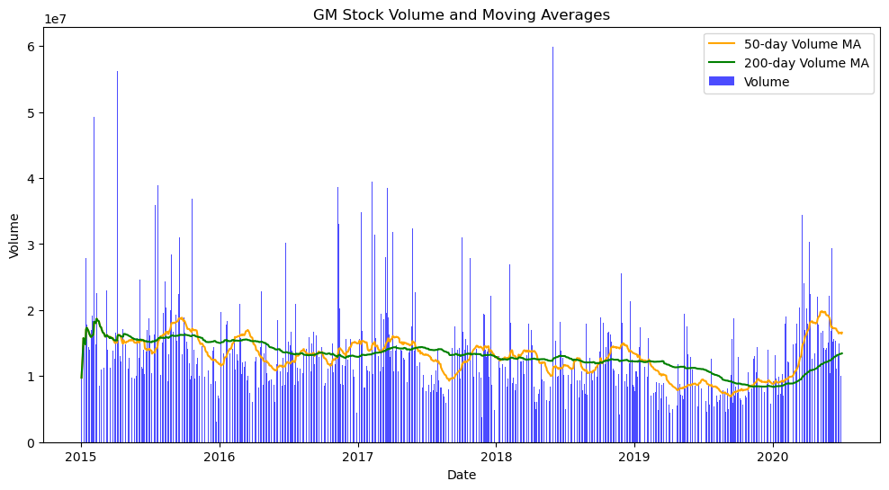
General Motors(GM) Stock Volume and Moving Averages
Demonstrates a stable trend in stock volume over the observed period, even though it reached 6 million stocks at a point between 2018-2019.

Slide 19
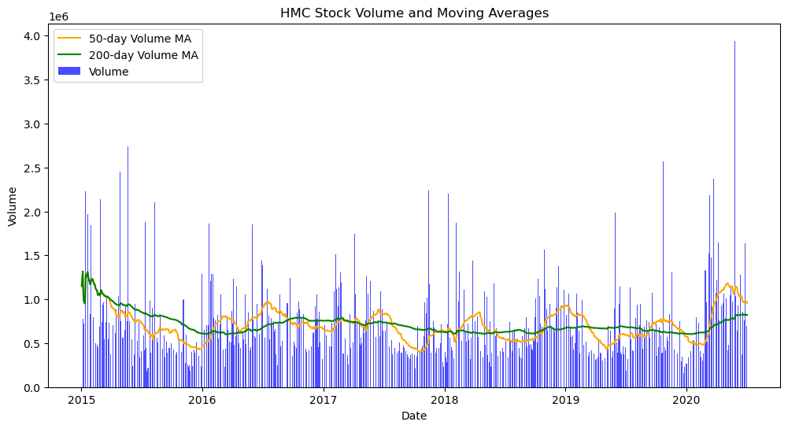
Honda(HMC) Stock Volume and Moving Averages
Shows a consistently stable trend in stock volume over time, without major fluctuations.

Slide 20
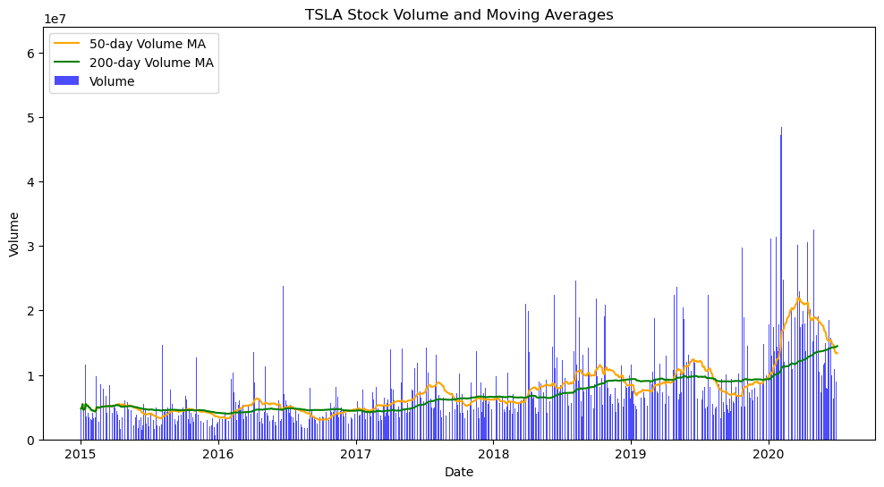
Tesla(TSLA) Stock Volume and Moving Averages
Indicates a steady and rising trend in stock volume, suggesting sustained market interest and trading activity.

Slide 21
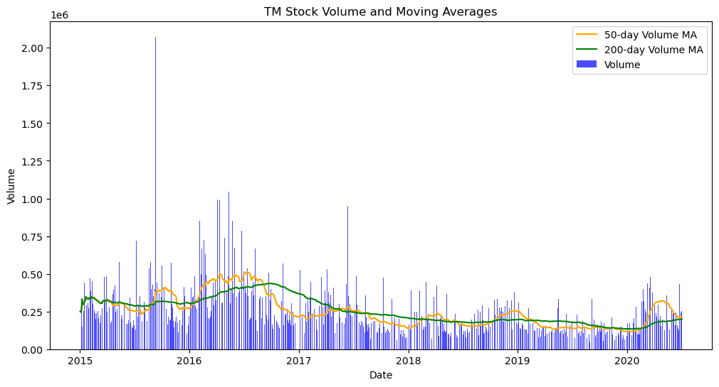
Toyota(TM) Stock Volume and Moving Averages
Displays a stable trend in stock volume over time; however, there is a notable observation of a decreasing trend after 2017, signalling a potential shift in market dynamics.

Slide 22
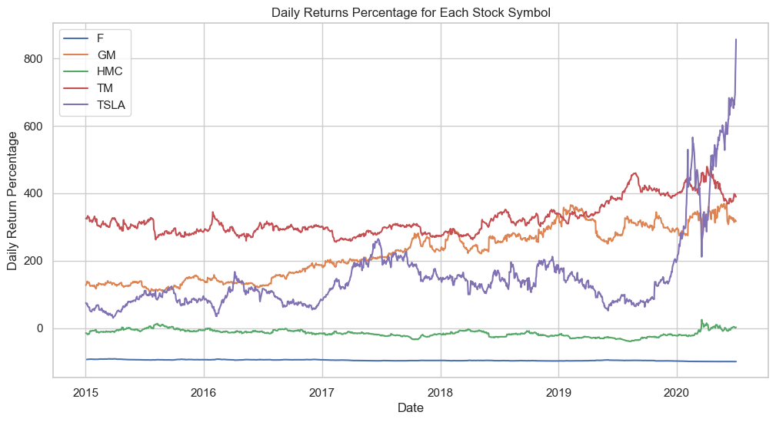
Daily Return Percentage
2015-2020 Trends:
Toyota Motors (TM) consistently led in daily return percentages.
General Motors (GM) closely followed TM during this period.
2020 Shift:
Tesla (TSLA) stocks surged, surpassing TM and GM.
Honda (HMC) and Ford (F):
Exhibited lower and stable daily returns.
Ford demonstrated notably consistent performance throughout the analysed period.

Slide 23


Correlation Heatmap

Slide 24
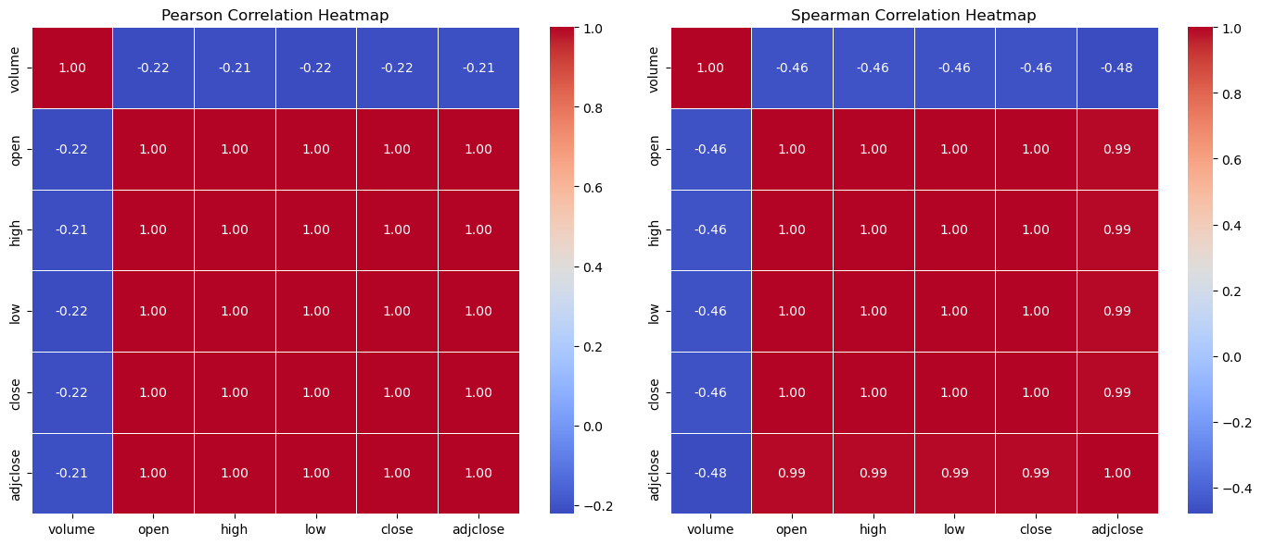
Overall Correlation

Slide 25
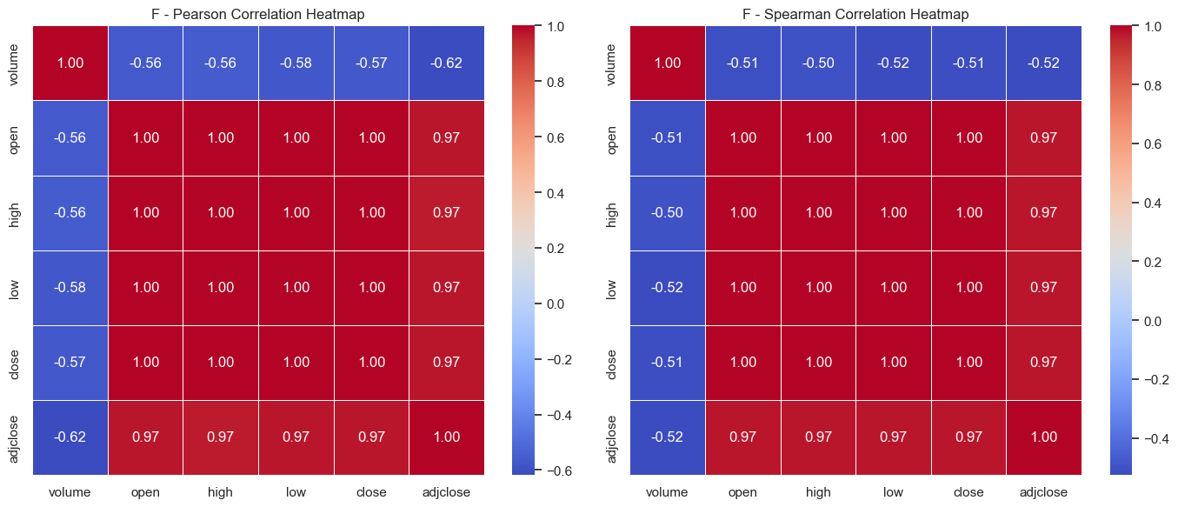
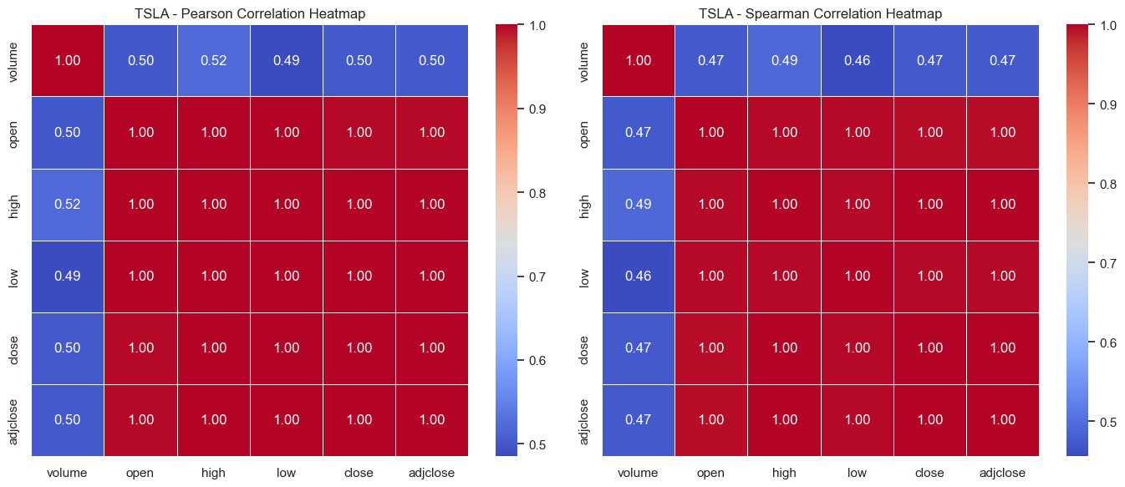
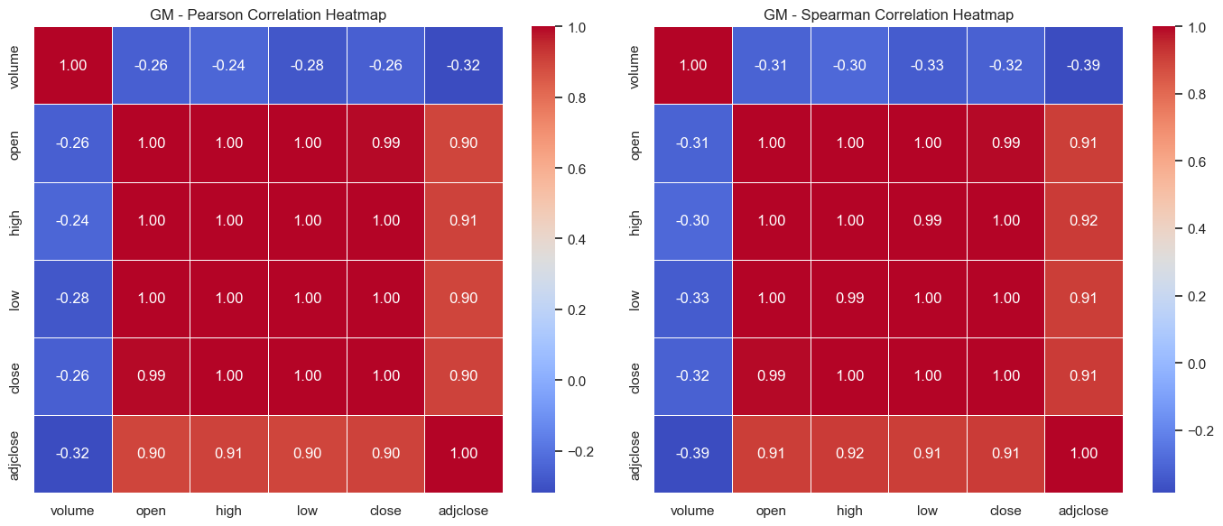
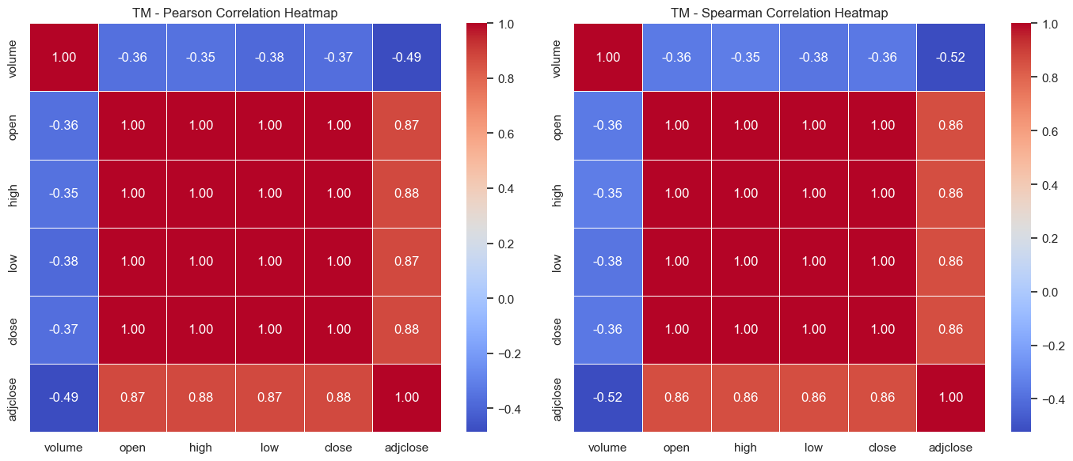
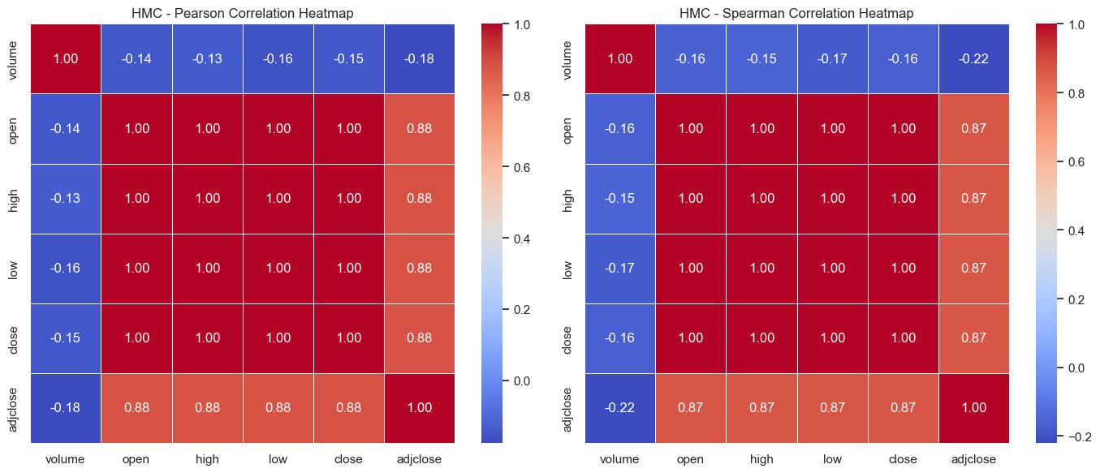
Stocks wise Correlation
Pearson Correlation:
Ford (F): Strong positive correlations in price-related columns.
GM, HMC, TM: Moderate to strong positive correlations.
Tesla (TSLA): Very strong positive correlations in price-related columns.
All: Varying degrees of negative correlations with trading volume, suggesting potential inverse relationships.
Spearman Correlation:
Trends consistent with Pearson results.
Similar patterns of associations between numerical variables for each company.
Significance:
Insights aid investors and analysts in understanding dependencies between trading volume and price-related metrics.
Ford
Tesla
General Motors
Toyota
Honda

Slide 26
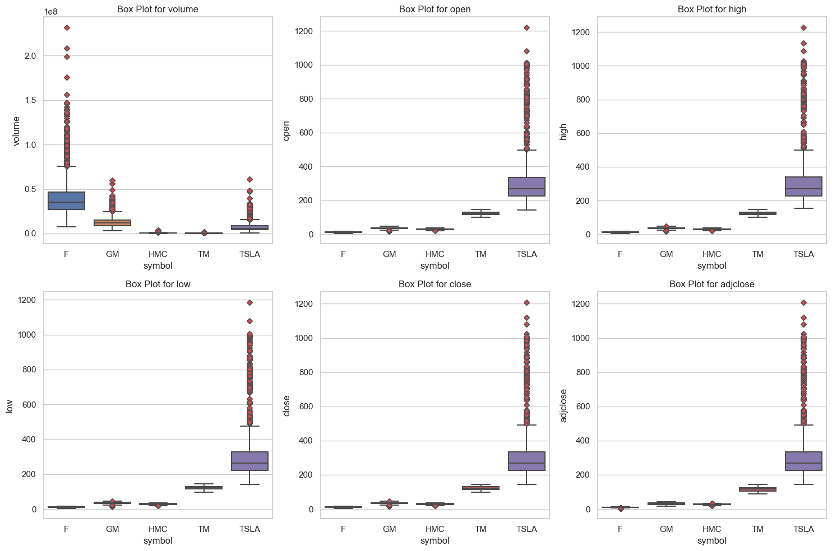
Outliers Overview
Volume:
All stocks exhibit outliers, indicating trading volume variability.
Close Price:
Tesla consistently has numerous outliers above the maximum whisker.
GM and HMC show fewer outliers.
F and TM have no outliers in the close price column.
Significance:
Outlier patterns offer insights into stock behaviour, with Tesla standing out prominently.

Slide 27

Step 2 Predictive Analysis

Slide 28
Long Short-Term Memory (LSTM)
The Long Short-Term Memory (LSTM) model is a type of recurrent neural network (RNN) designed for sequential data. It excels in capturing long-term dependencies, mitigating vanishing gradient issues, and handling time series forecasting.
Sequential Data Handling:
LSTM excels at processing sequences, a critical feature for analysing the sequential nature of stock price data.
Long-Term Dependency Capture:
The model effectively captures long-term dependencies in stock prices, accommodating the complex patterns observed in financial time series.
Mitigation of Vanishing Gradient:
LSTM's architecture addresses the vanishing gradient problem, enhancing its ability to learn and retain information over extended periods.
Flexibility for Experimentation:
The LSTM model offers flexibility in hyperparameter tuning, allowing for experimentation to adapt the model to diverse datasets and prediction tasks in the stock market.

Slide 29

Steps of The Predictive Analysis
Import Essential Libraries
Data Preprocessing
Split Data & Sequence Generation
Build LSTM Model
Compile and Initialize Model
Train Model
Evaluate the Performance

Slide 30
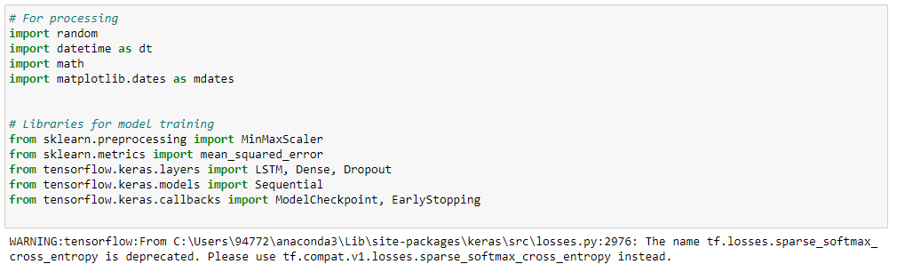
Step1 : Import Essential Libraries
Data Processing:
Used versatile libraries (random, datetime, math, matplotlib.dates) for data handling and visualization.
Model Training:
Employed MinMaxScaler and mean_squared_error for preprocessing and evaluation.
Built LSTM model with Keras, emphasizing simplicity and effectiveness.
Training Process:
Implemented Keras callbacks (ModelCheckpoint, EarlyStopping) for efficiency and prevention of overfitting.

Slide 31
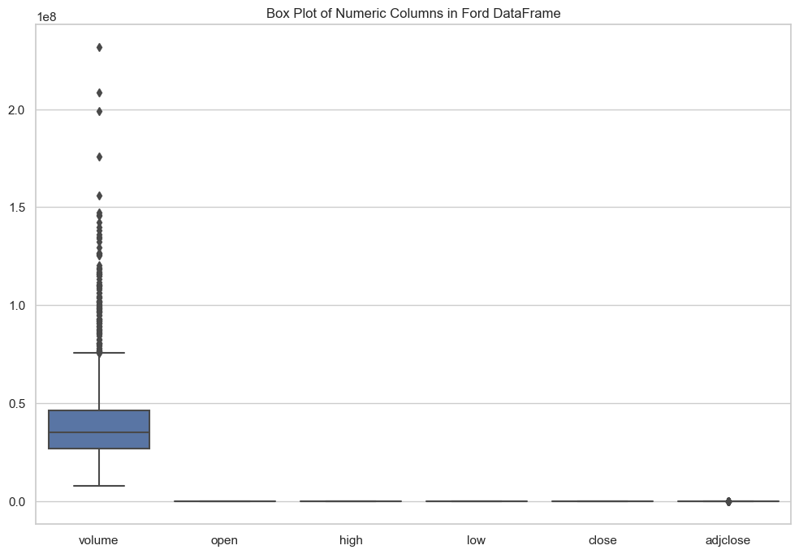
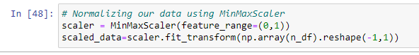
Step 2 : Data Preprocessing of Ford Data
Generated box plots for each column in the dataset.
Checked for outliers in each feature to assess data distribution.
Specifically examined the box plot for the target variable, which is the stock closing price.
Confirmed that the stock closing price has no outliers based on the box plot analysis and proceeded with the stock closing price as target variable.
Normalized data with MinMaxScaler (0,1) for effective model training, transforming n_df to scaled_data.

Slide 32
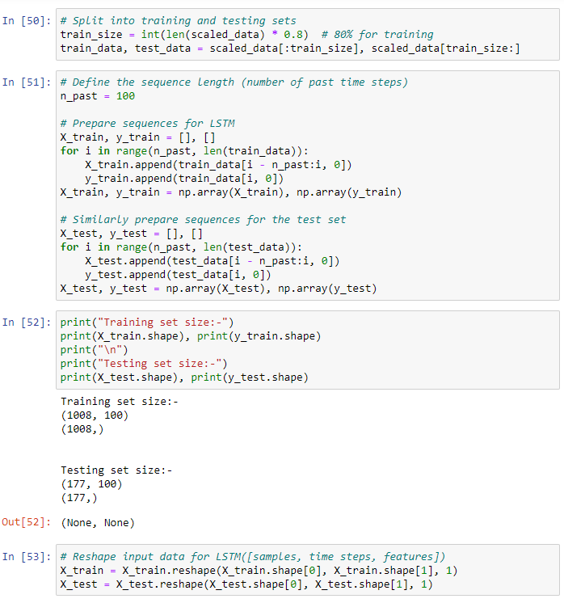
Step 3: Split Data & Sequence Generation
Data Splitting:
Utilized an 80-20 split for training and testing data, ensuring ample data for model training and separate evaluation.
Sequence Generation:
Created sequences with a focus on the past 100-time steps, enabling the LSTM model to capture temporal dependencies.
Training and Testing Sets:
Formed sequences (X_train, X_test) and target values (y_train, y_test) to train and evaluate the model.
Data Reshaping:
Reshaped input data to match the LSTM model's [samples, time steps, features] format, facilitating model compatibility and effective learning.

Slide 33
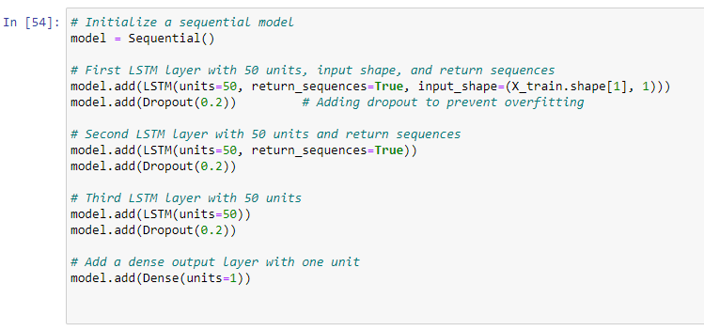
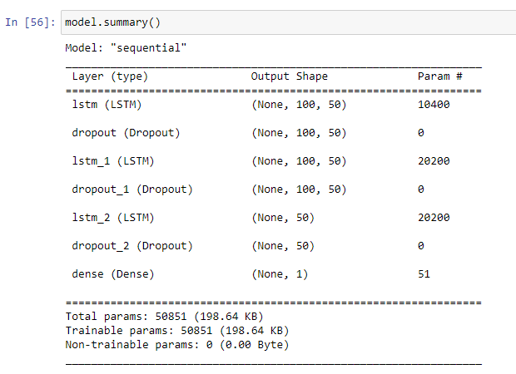
Step 4: Build the LSTM Model
Sequential Model Setup:
Initialized a sequential model for stacking layers.
LSTM Layers:
Configured three LSTM layers with 50 units each.
Used 'return sequences=True' for capturing temporal patterns.
Added Dropout (20%) after each LSTM layer for regularization.
Dense Output Layer:
Included a dense output layer with one unit for continuous value prediction.
Input Shape:
Specified input shape as 'input_shape=(X_train.shape[1], 1)' for time series data.
Regularization:
Employed Dropout to prevent overfitting and enhance generalization.
Model Complexity:
Balanced model complexity with generalization through layer stacking.
Optimization:
Emphasized experimentation for optimizing model performance.

Slide 34
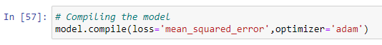
Step 5: Compile and Initialize Model
Loss Function Selection:
In the code, the chosen loss function is 'mean_squared_error.' This metric measures the mean squared difference between predicted and actual values, making it suitable for regression tasks like stock price prediction.
Optimizer Choice:
The 'adam' optimizer is selected for model compilation. Adam is an adaptive learning rate optimization algorithm that efficiently updates model weights, helping the model converge faster during training.
Compilation Summary:
The model.compile line succinctly summarizes the compilation step, bringing together the chosen loss function and optimizer. This step is crucial for configuring the model's training process before initiating the training phase.

Slide 35
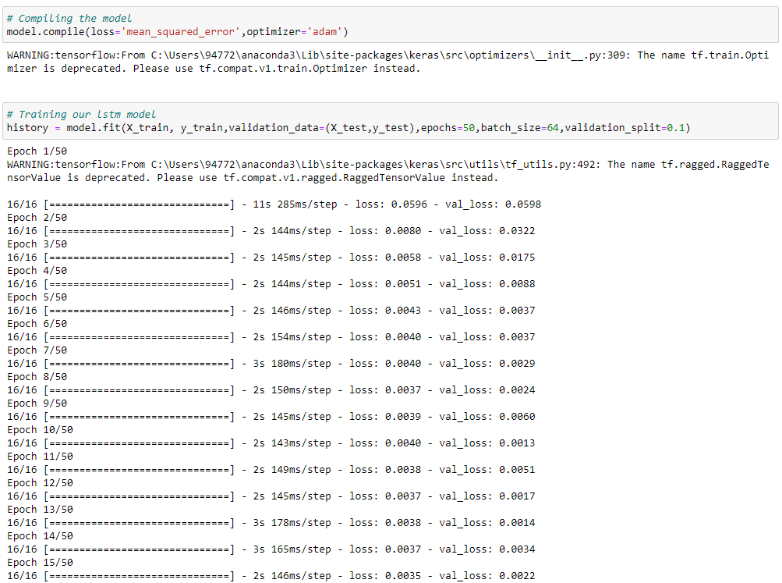
Step 5: Train Model
This code snippet captures the essence of training the LSTM model and monitoring its validation performance over 50 epochs.
Training the LSTM model: The fit method is used to train the LSTM model.
Input Data: X_train represents the input sequences, and y_train represents the corresponding output sequences.
Validation Data: Validation data (X_test, y_test) is provided to evaluate the model's performance during training.
Epochs: The model is trained for 50 epochs, specifying the number of times the entire dataset is processed.
Batch Size: Training is performed in batches of 64 sequences.
Validation Split: 10% of the training data is used as a validation set to monitor model performance during training.

Slide 36
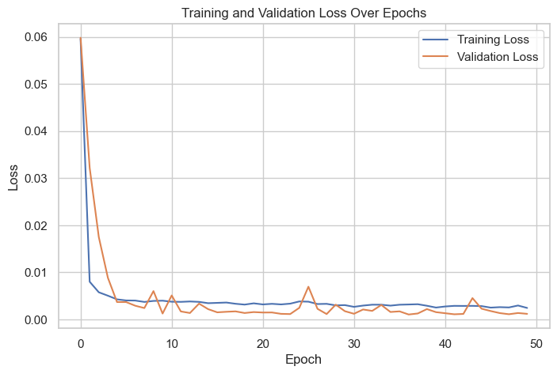
Step 5: Train Model

Slide 37
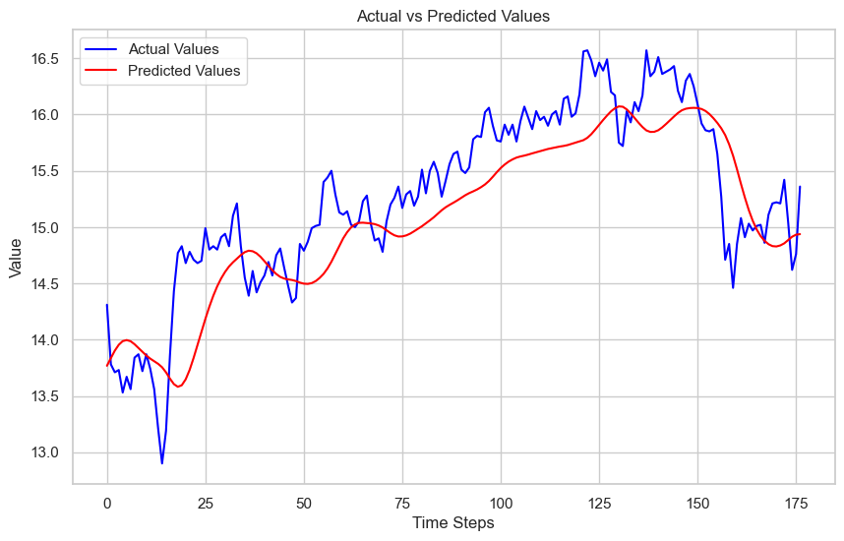
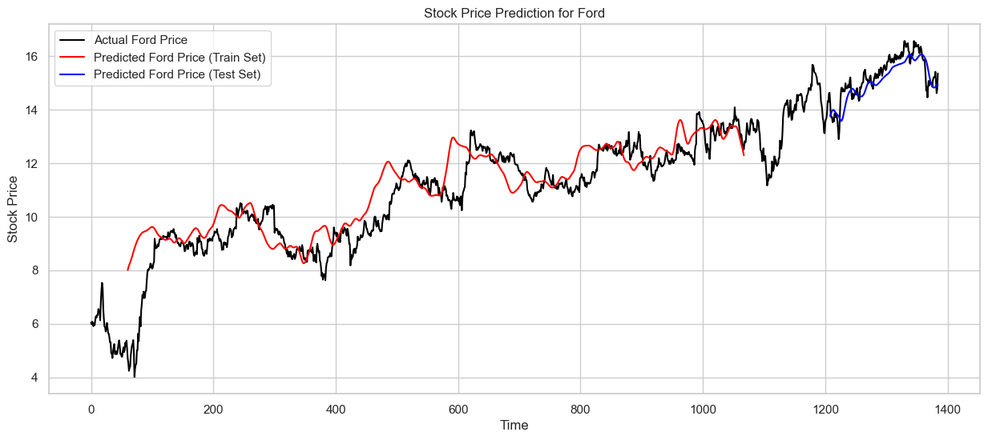
Step 6: Evaluate the Performance
Model Evaluation Metrics:
Train Data RMSE: 0.400
Test Data RMSE: 0.435
MAPE: 0.0234
Accuracy: 97.66%
R-squared (R²) Train: 0.934
R-squared (R²) Test: 0.693
Observation:
The quantitative metrics suggest strong model performance on the training set.
However, the actual vs. prediction graph doesn't align well with expectations, indicating potential challenges in generalization to unseen data.

Slide 38

Different approach to Improve Model Performance

Slide 39
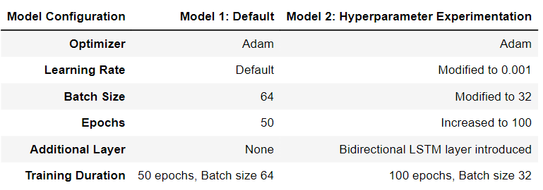
Experimenting with Hyperparameters
To get a better model the hyperparameters were changed. The configuration done to this model is given in the table above

Slide 40
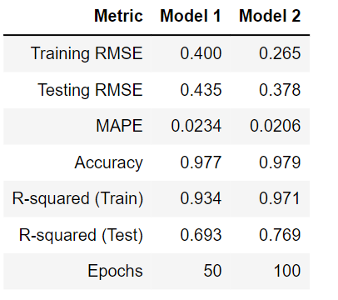
Model Performance Comparision
RMSE:
Model 2 has lower RMSE values for both training and testing datasets compared to Model 1. Lower RMSE indicates better accuracy in predicting the stock closing prices.
MAPE and Accuracy:
Model 2 shows a lower MAPE and a higher accuracy compared to Model 1. This suggests that, on average, the percentage difference between predicted and actual values is smaller in Model 2, leading to higher accuracy.
R-squared:
Model 2 has higher R-squared values for both training and testing datasets. A higher R-squared value indicates that a larger proportion of the variance in the dependent variable is explained by the independent variables. Therefore, Model 2 is better at explaining the variability in the data.
Epochs:
Model 2 was trained for more epochs (100) compared to Model 1 (50). This suggests that the longer training duration might have allowed Model 2 to learn more complex patterns in the data.

Slide 41
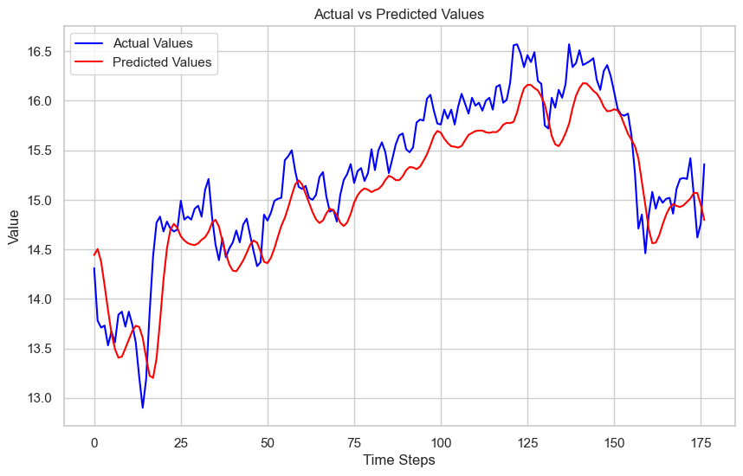
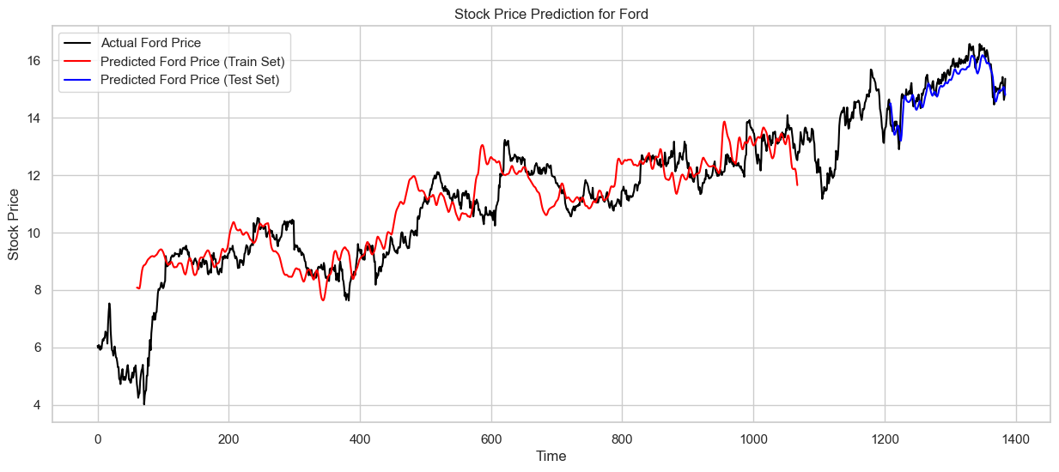
Visual Comparision
Model 1
Model 2
According to your visual inspection, Model 2's predicted values and patterns are more similar to the actual values than those of Model 1. This aligns with the quantitative metrics, indicating that Model 2 has a better overall performance.

Slide 42

Main Observations and Learning Points:
Hyperparameter Tuning Matters: Adjusting hyperparameters can significantly impact model performance. Model 2's success demonstrates the importance of experimenting with learning rates, batch sizes, and model complexity.
Model Complexity and Training Duration: Increasing the number of epochs allowed Model 2 to learn more complex patterns. However, careful monitoring is essential to avoid overfitting.
Visual Inspection: Visualizing model predictions against actual values is a valuable step for qualitative assessment and model selection.

Slide 43

Strengths and Weaknesses:
Strengths:
Model 2 exhibited improved accuracy and predictive power.
Hyperparameter tuning and architectural changes positively influenced the model's performance.
Weaknesses:
Overfitting risk: While Model 2 performs well on the testing set, it's crucial to monitor for potential overfitting, especially with an increased number of epochs.
The comparison is limited to two models; exploring a broader range of architectures and hyperparameters could provide further insights.

Slide 44

Improvements for the Future:
1. Ensemble Methods:
Explore the use of ensemble methods, such as bagging or boosting, to combine predictions from multiple models. This can enhance the overall predictive performance and provide more robust results.
2. Feature Engineering:
Consider incorporating additional relevant features or performing feature engineering to capture more nuanced information from the data. This could involve extracting time-based features, technical indicators, or sentiment analysis from external sources.
3. Regularization Techniques:
Implement advanced regularization techniques, such as L2 regularization, to prevent overfitting. Regularization helps to control the complexity of the model and improve its generalization to unseen data.
4. Cross-Validation:
Utilize cross-validation techniques to assess the model's performance across multiple data splits. This helps ensure that the model's performance is consistent and reliable on different subsets of the data.
5. Incorporate External Factors:
Consider integrating external factors that may influence stock prices, such as news sentiment, economic indicators, or geopolitical events. Incorporating these factors into the model can provide a more comprehensive understanding of the underlying dynamics affecting stock prices.

Slide 45
THANK YOU

